Slide 1
comprehensive digital marketing
project

Slide 2

CROMPTON GREAVES CONSUMER ELECTRICALS
one of the leading consumer companies in India with a 90+ years old brand legacy.
As of February 2016, we are an independent company under professional management and have 2 business segments – Lighting and Electrical Consumer Durables.
They market their products under the “Crompton” brand name in India and select export markets.

Slide 3
MISSION
In this competitive world every organization has its own mission and ideology.
To be the best one should have mission and also must follow ethics in the work they are doing.
Crompton have came up with their unique mission, To provide the best styles and the highest industry quality in Consumer Products and accessories.
VALUES OF THE ORGANIZATION:-
Product quality,
Reliability
performance

Slide 4
USP:-
A pioneer and has top leadership position in the management and application of electrical energy.
TAGLINE:-
To survive in this competitive business world Crompton created their own tagline.
'Let's Hangout Ghar Pe! is the tagline of crompton.

Slide 5

Symphony, an Indian Multi-National Company with presence in over 60 countries is the world's largest manufacturer of air-coolers. From inventions to innovations, energy responsibility to environment stewardship, Symphony is a market leader which has been providing comfort cooling to its customers for generations.
COMPETITOR ANALYSIS
symphony

Slide 6

Havells India Limited is an Indian multinational electrical equipment company, based in Noida. It was founded by Haveli Ram Gandhi, later sold to Qimat Rai Gupta who was his distributor.
HAVELLS

Slide 7

Bajaj Electricals Ltd (BSE: 500031) is an Indian consumer electrical equipment manufacturing company based in Mumbai, Maharashtra.^{[5]} It is a part of the ₹380 billion (US$4.8 billion) Bajaj Group. It has diversified with interests in lighting, luminaries, appliances, fans, LPG based generators,^{[6]} engineering and projects. Its main domains are lighting, consumer durable, engineering and projects. Lighting includes lamps, tubes and luminaire.

Slide 8
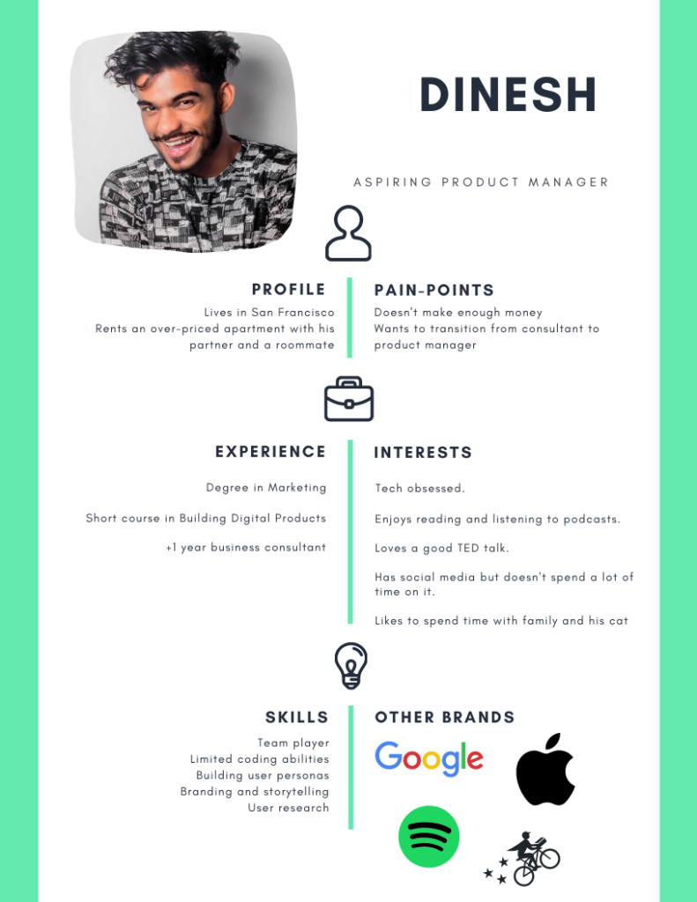
User persona

Slide 9
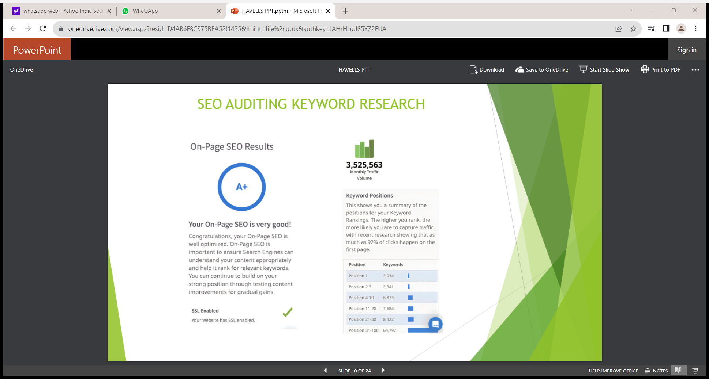

Slide 10
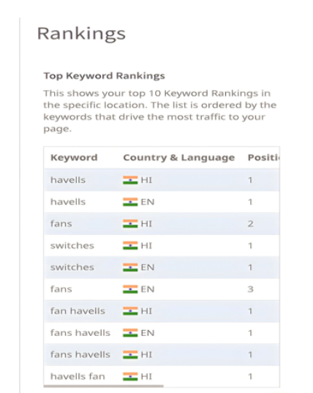
KEYWORD RESEARCH :

Slide 11
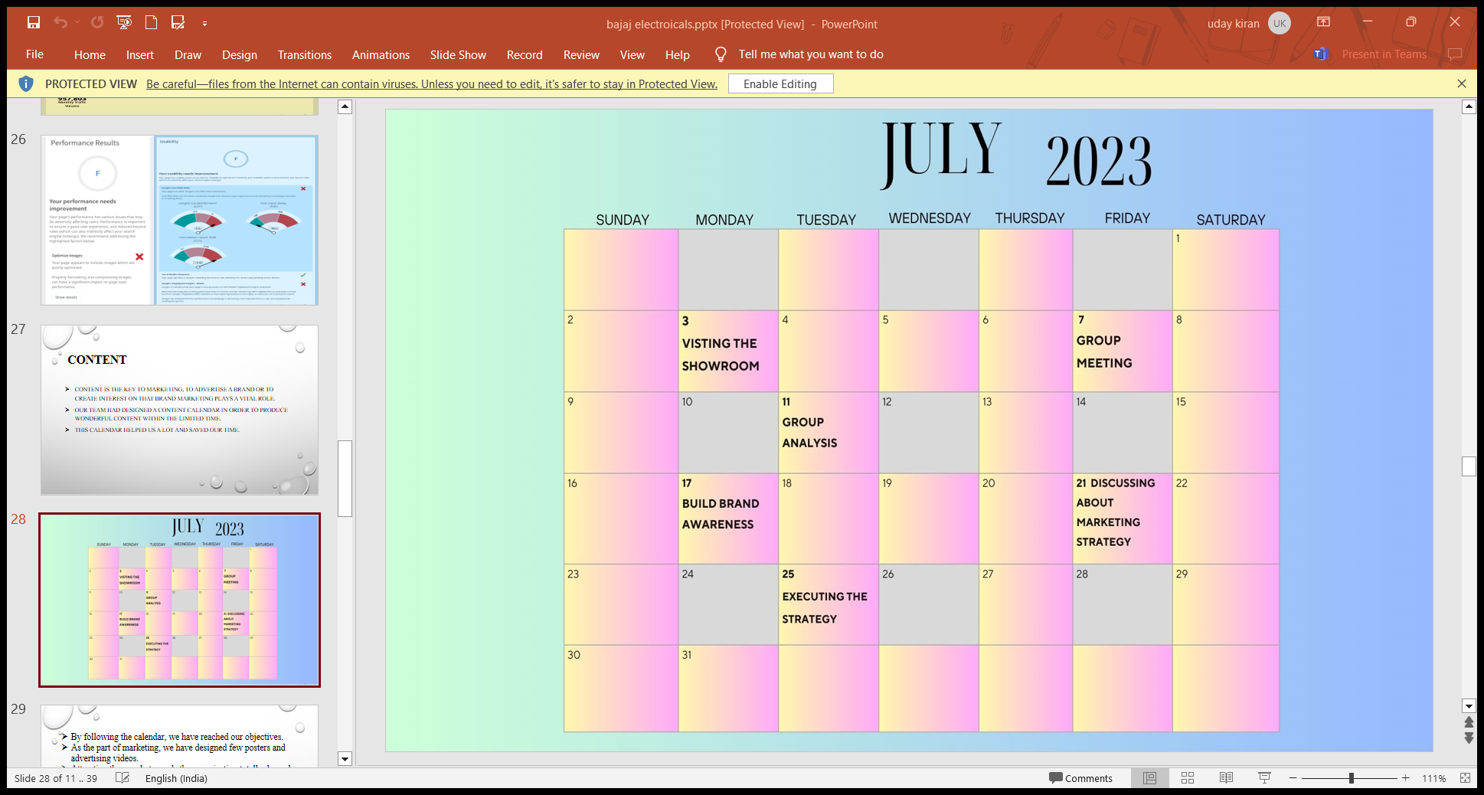
CONTENT IDEAS AND MARKETING STRATEGIES

Slide 12
By following the calendar we have reached our objectives.
As the part of marketing we have designed few posters and also advertising videos.
Attracting the people towards the organization totally depends on the way we showed about the organization.
Its been a tough challenge to our team to get thoughts regarding content.
We have explored different faces of the organization, like their infrastructure, about their clients and we heard the reviews of the employees of the organization.
After this we have discussed together and made this content.

Slide 13
Part 4: Content Creation and Curation (Post creations, Designs/Video Editing, Ad Campaigns over Social Media and Email Ideation and Creation)
FORMAT 1 : Advertising in linked ln.
AIM : To reach more audience around the world.
Date : 27-07-2023
IDEA : Crompton new product launch
FORMAT 2 : Creating ads and posting in social media
AIM : To create brand awareness
Date: 27-07-2023
Idea : Crompton season end sale.

Slide 14
FORMAT 3 : creating videos
AIM : To create brand awareness and to reach more audience
Date: 27-07-2023
Idea : Crompton mind blowing offers

Slide 15
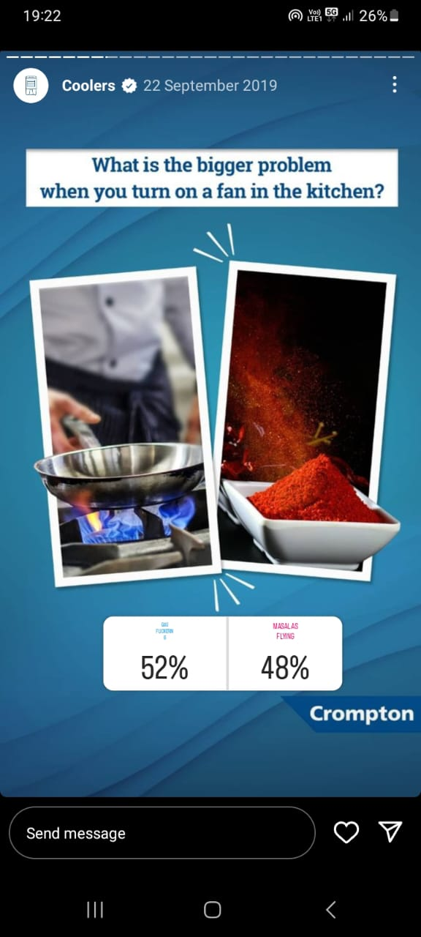
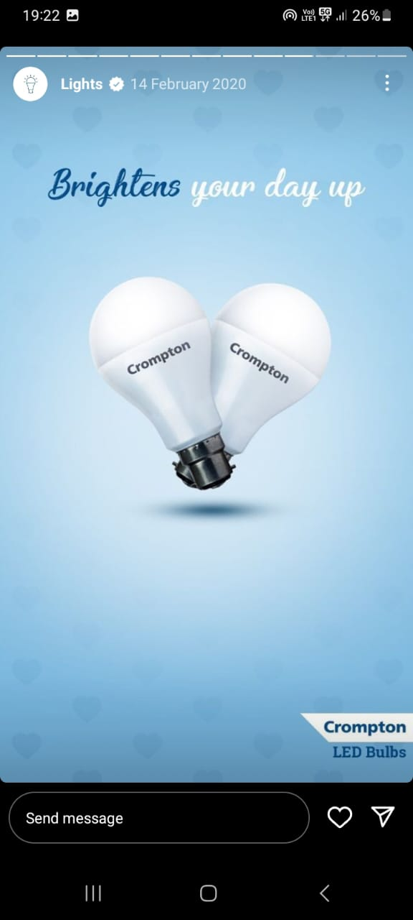
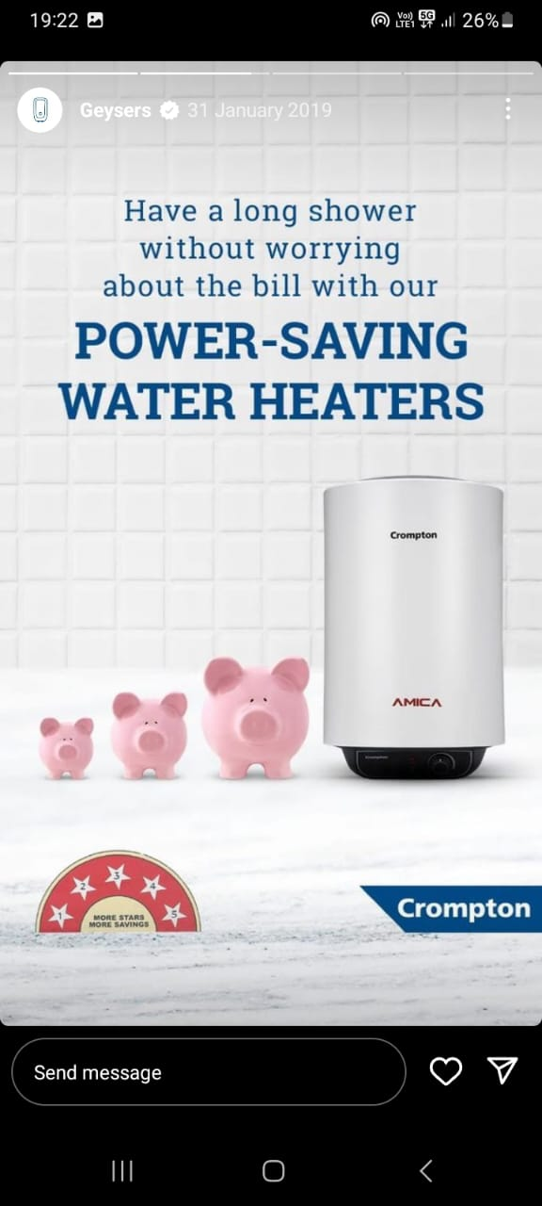
INSTAGRAM STORIES

Slide 16
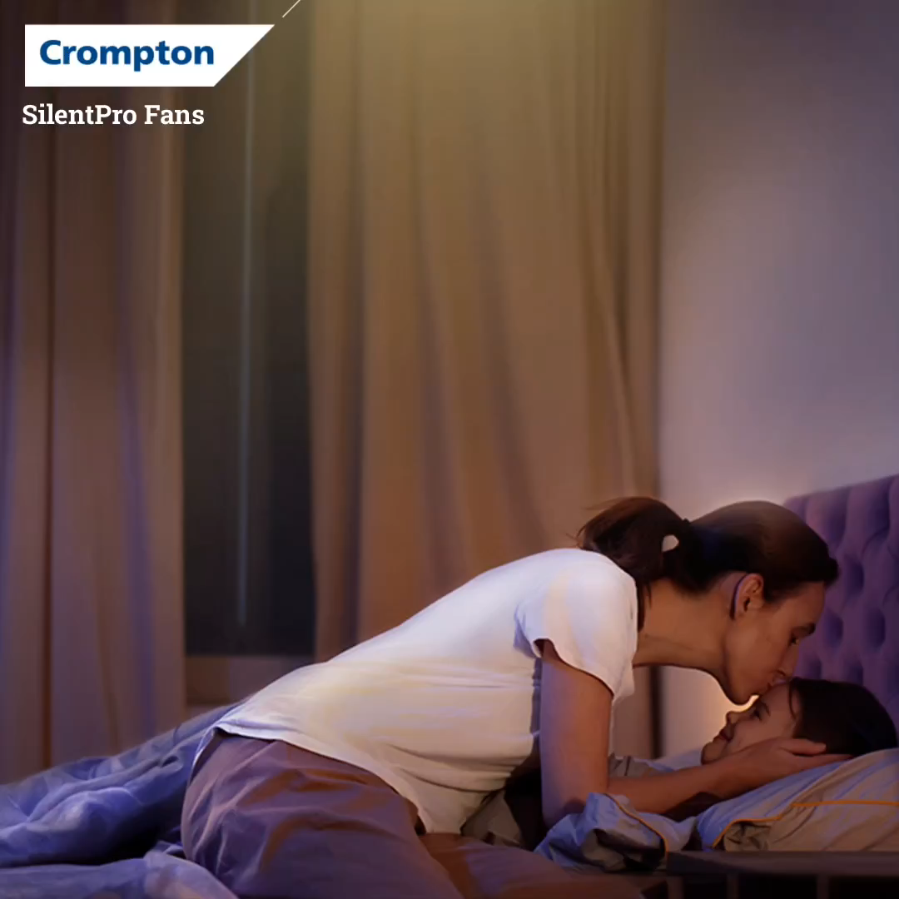
VIDEO DESIGNING

Slide 17
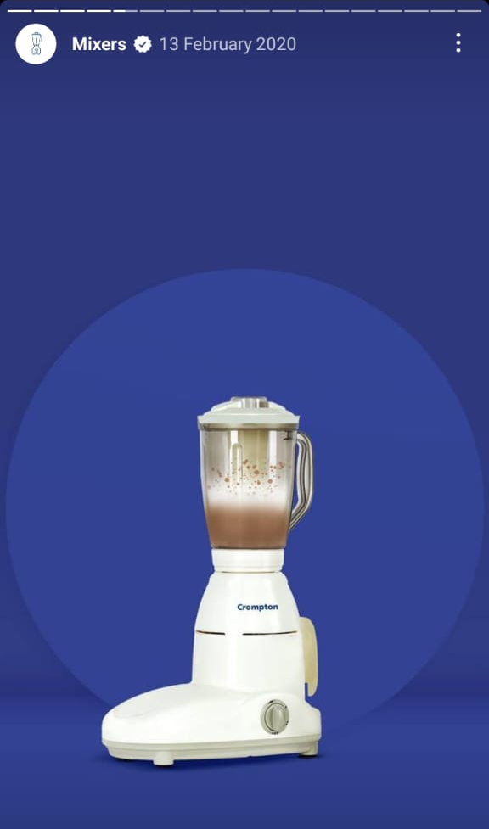
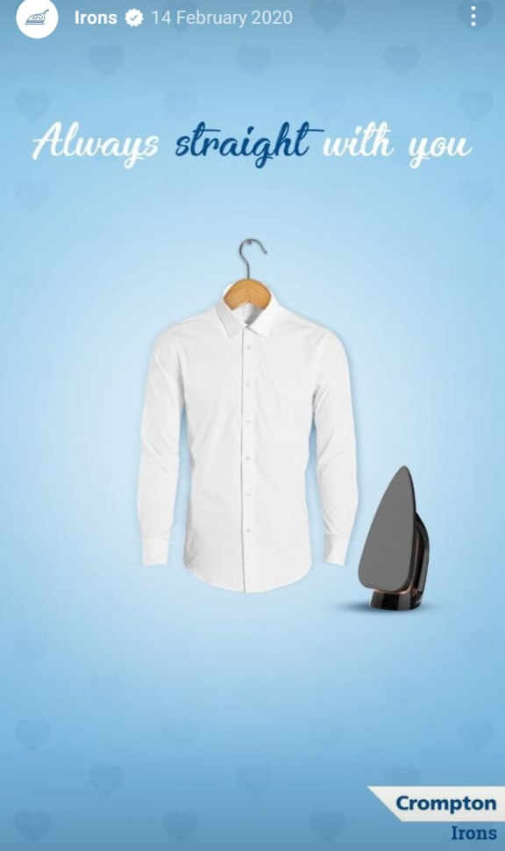
SOCIAL MEDIA AD CAMPAIGING

Slide 18
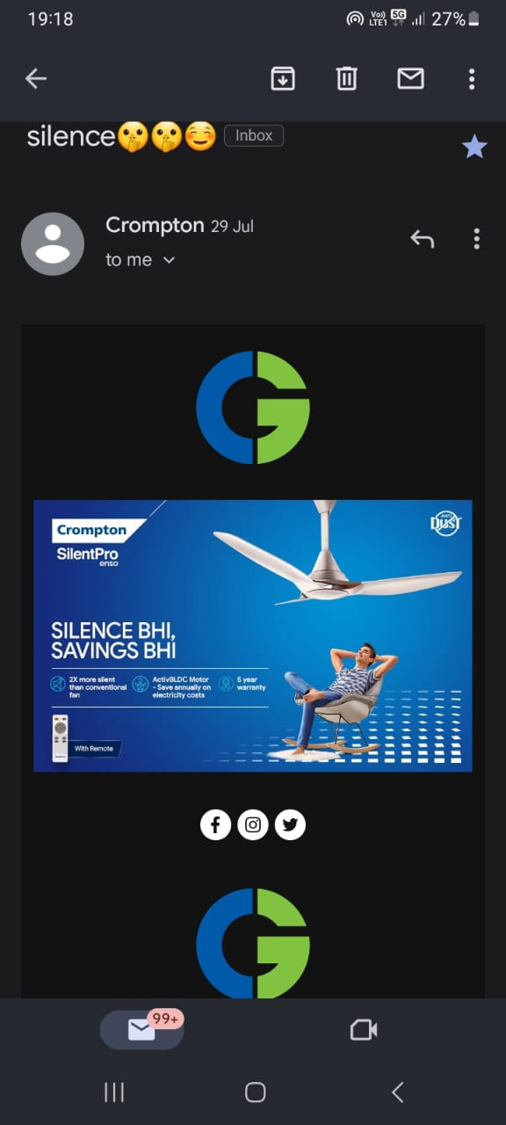
EMAIL AD CAMPAIGING
WE HAVE USED THIS MAIL FOR INCREASING BRAND AWARENESS.

Slide 19
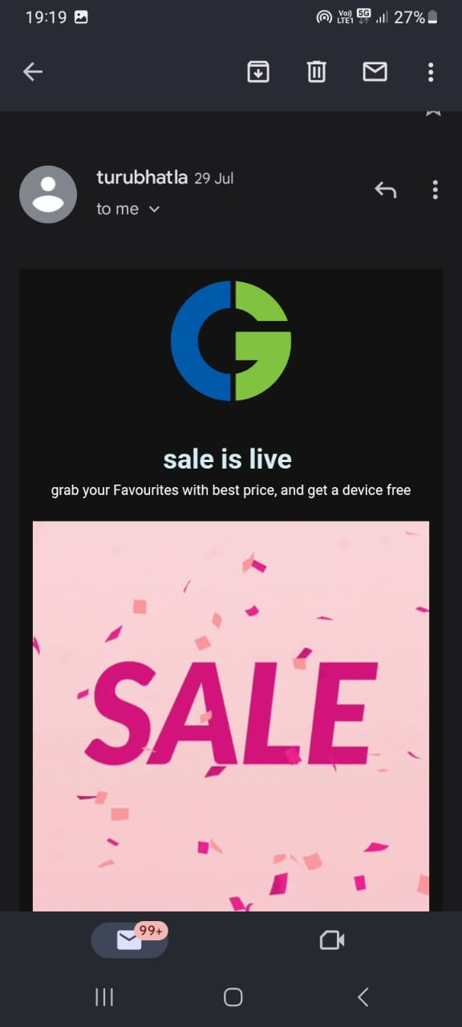
EMAIL AD CAMPAIGN -2
WE HAVE USED THIS EMAIL FOR LEAD GENERATION.

Slide 20
CHALLENGES FACED AND LESSONS LEARNED
By doing this project we have learnt many new things.
We have faced many challenges while doing SEO part and content making ideas.
For this project we have explored many websites and read few magazines to know more about the organization.
By doing these things we have improved our abilites.
By this project we have enhanced our in communication and presentation skills.

